Slide 1
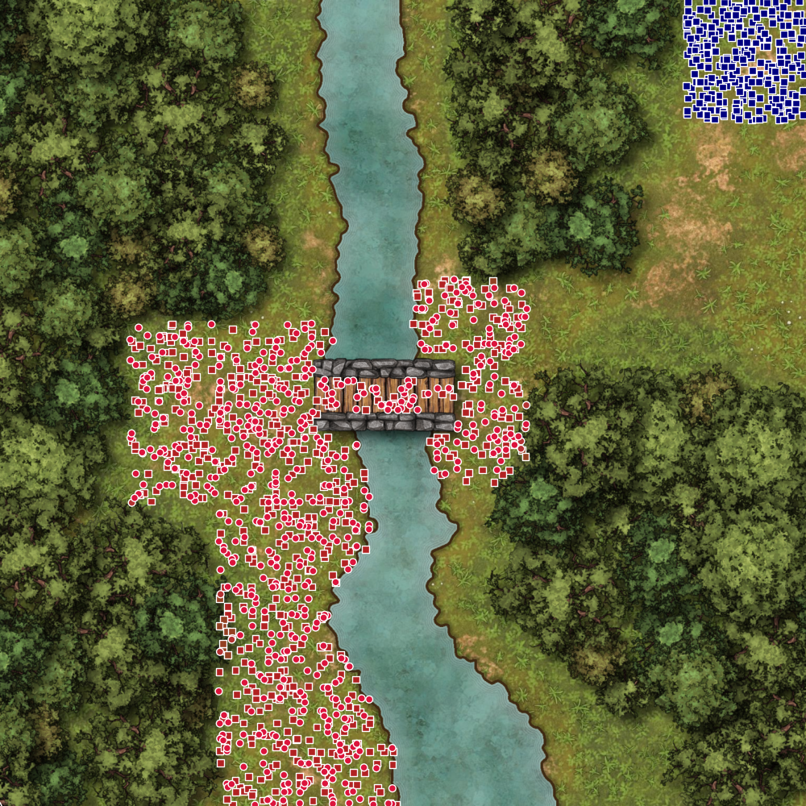
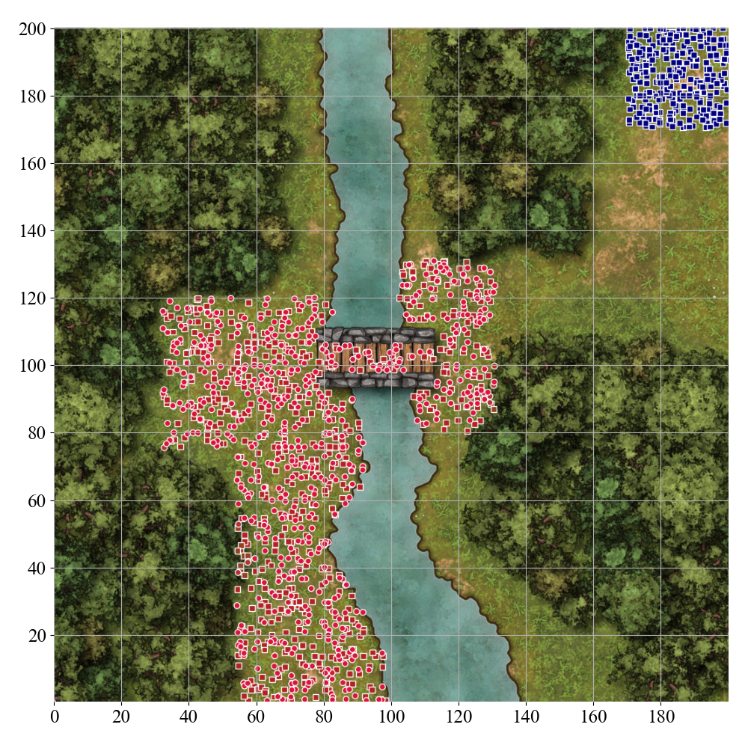
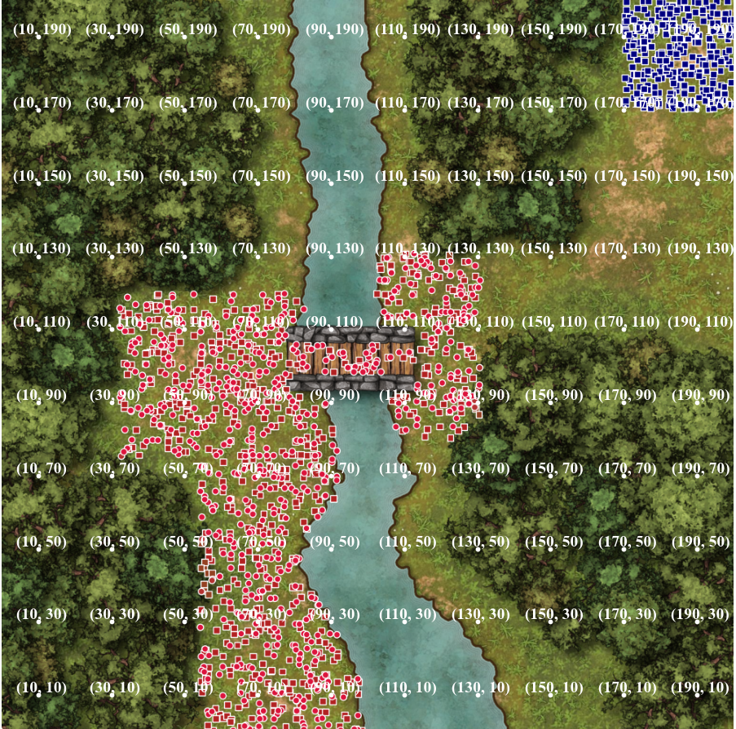
(a) Textual description
River: water at (46, 110) - (102, 200), (85, 57) - (107, 91), (82, 36) - (111, 58), (98, 0) - (134, 34)
Bridge: normal at (78, 97) - (112, 106)
Bridge northern wall: building at (77, 105) - (113, 109)
Bridge southern wall: building at (77, 92) - (113, 96)
West Forest: trees at (11, 101) with radius 10
North-West Forest: trees at (33, 159) with radius 30
South-West Forest: trees at (23, 44) with radius 20
North-East Forest: trees at (135, 156) with radius 20
East Forest: trees at (164, 71) with radius 30
(b) Raw image
(c) Grid image
(d) Scaffolding image

